Slide 1
Medical Health Record Series
Project Contributor(s): Sabur Oladipupo Bello

Slide 2
Rationale Statement
This project seeks to develop LDA and QDA models for Mr. John Hughes MHR_dataset.csv dataset and evaluate its effectiveness.
The dataset consists of 1014 observations and 7 variables that information about student performance.
Independent Variables:
Age: : Any ages in years when a women during pregnant
Systolic BP: Upper value of Blood Pressure in mmHg, another significant attribute during pregnancy
Diastolic BP: Lower value of Blood Pressure in mmHg, another significant attribute during pregnancy
BS: Blood glucose levels is in terms of a molar concentration, mmol/L
BodyTemp: Body Temperature in Fahrenheit
HeartRate: A normal resting heart rate in beats per minute
Dependent Variable:
Risk Level: Predicted Risk Intensity Level (High Level, Mid Level, Low Level)
The goal is to perform Discriminant analysis for classification and dimensionality reduction when performing classification tasks on MHR this dataset, particularly in the context of supervised learning.
By leveraging Linear Discriminant Analysis (LDA) and Quadratic Discriminant Analysis (QDA), given the features of the dataset, our models will be juxtaposed.

Slide 3
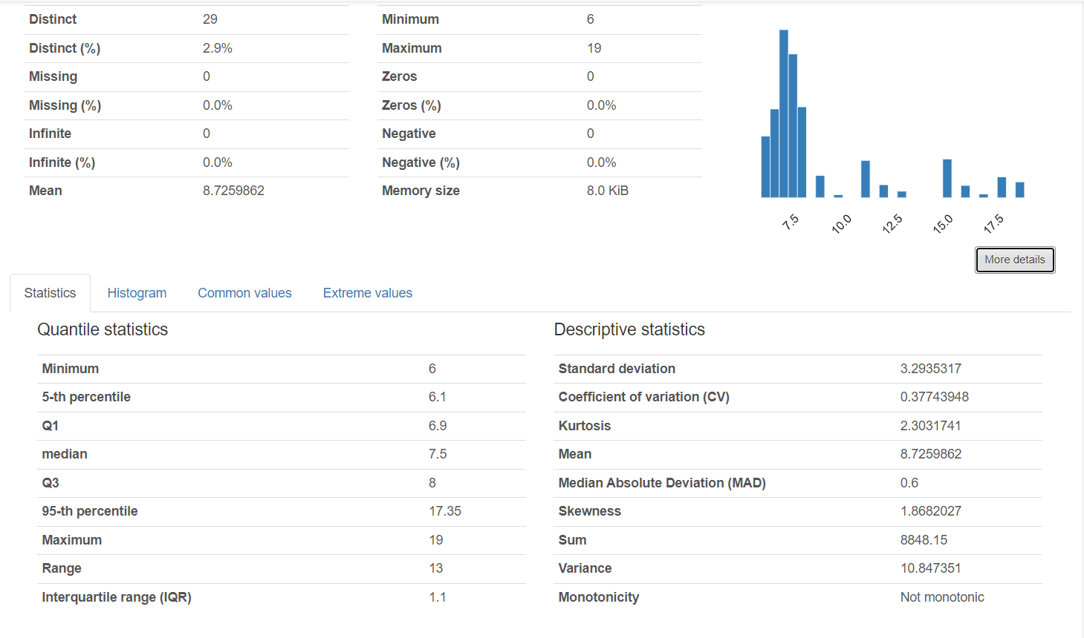
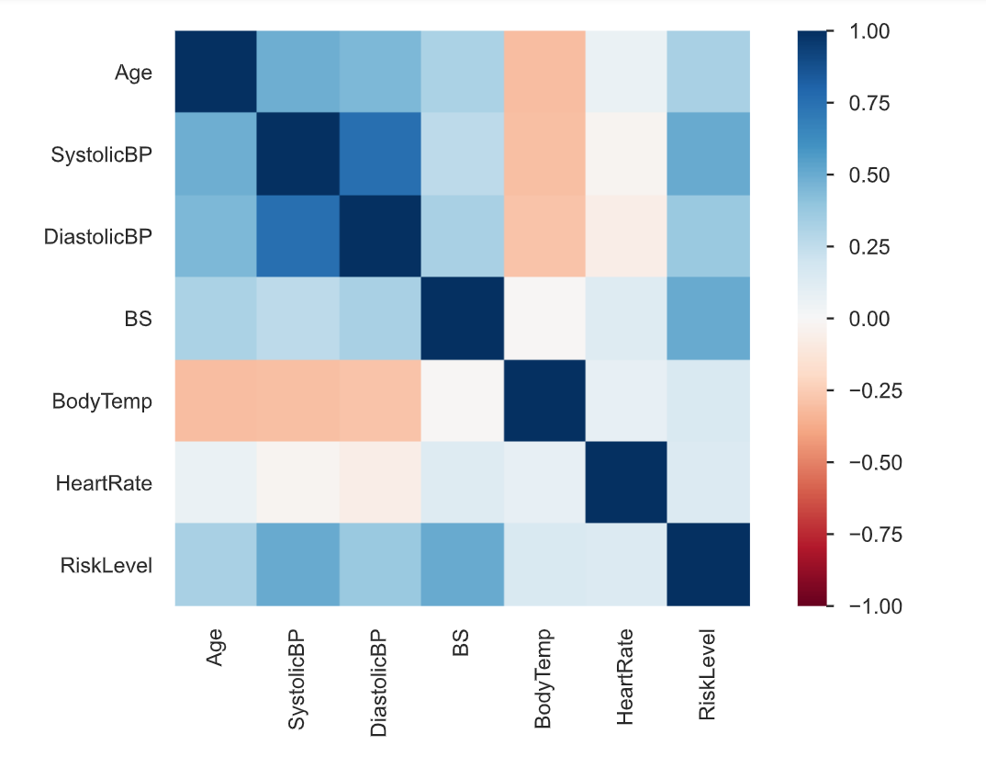
Pandas Profile Report: Key Insight
Overview Section:
MHR dataset consists of six numerical and one categorical variable.
MHR dataset has 0 missing values but 304 (30.0%) duplicate rows
Bloodglucose (BS) is highly overall correlated with RiskLevel.
Variable Section:
Extreme Values: Upto 8.6% of DiastolicBP observations have an extreme value 100, while 1% of observations have an extreme SystolicBP value of 160
Skewness: Distribution of BloodGlucose (BS) is positively skewed.
Coefficient of Variation (CV): Bloodglucose (BS) has a CV value of 0.38
This information can be valuable for feature selection and assessing class separability.
Bloodglucose (BS) has a Median Absolute Deviation (MAD) value of 0.6, and Standard Deviation of 3.29; This combination suggests that the "Bloodglucose" variable has moderate to high variability.
Correlation Section:
RiskLevel is moderately correlated to Bloodglucose (BS) (0.505), and SystolicBP ( 0.5)

Slide 4
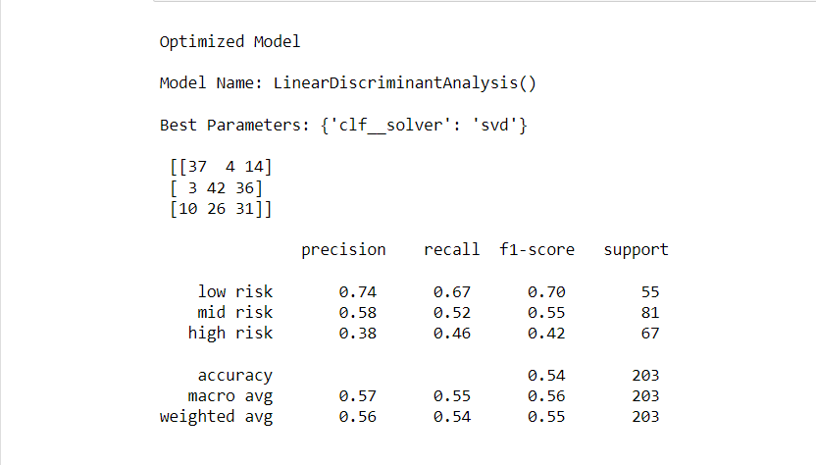
Confusion Matrix/Classification Report – Optimized LDA
Precision: The precision (performance metric) of the optimized model for the “low risk" level is 0.74, on the “mid risk” level it is 0.58 while for the “high risk" class, it is 0.38
This indicates that the model has a moderately high ability to correctly identify low risk, moderately identify mid risk, while it performed poorly identifying high risk.
Mid risk and high risk still produces a considerable amount of false positive
Recall: The ‘mid risk’ level (0.67) has the highest proportion of actual positives which were correctly classified. The proportion of the models which produced false negatives for ‘high risk’ level (0.38) is largest (I.e. only 38% recall rate)
F1-Score: With very similar values, the low risk and mid risk model show a fair glean to a perfect model than the combination of precision and recall – F1 score of the high risk at 0.28
Accuracy: The optimized LDA model is only making predictions right 54% of the time
Support: The number of metrics are quite closely split
Because our classes are relatively balanced that’s why our Macro Avg and Weighted avg are quite similar.
Macro Avg and weighted Avg are the average precision and weighted average precision of precision, recall and F1 score. Weighted average favors the majority class.

Slide 5
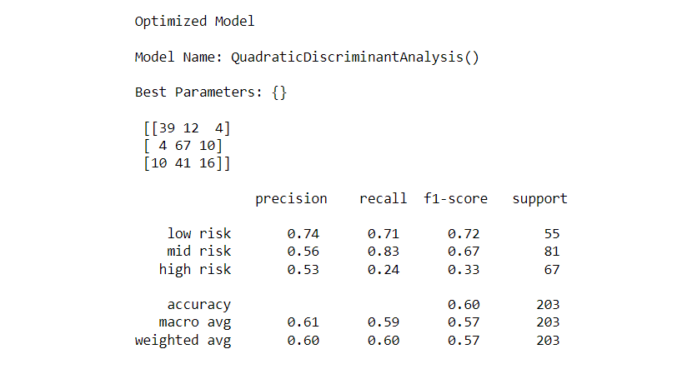
Confusion Matrix/Classification Report – Optimized QDA
Precision: The precision (performance metric) of the optimized model for the “low risk" level is 0.74, on the “mid risk” level it is 0.56 while for the “high risk" class, it is 0.53
This indicates that the model has a moderately high ability to correctly identify low risk, and moderately identify ‘mid risk’, and ‘high risk’.
Mid risk and high risk still moderately produces a considerable amount of false positives
Recall: The ‘mid risk’ level (0.83) has the highest proportion of actual positives which were correctly classified. The model performed fairly with ‘low risk’ classifications too. However, the proportion of the models which produced false negatives for ‘high risk’ level (0.24) is large (I.e. only 24% recall rate)
F1-Score: With very similar values, the F1-score of low risk predictions (0.72) show a greater glean to a perfect model than the combination of precision and recall – F1 score of the high risk at 0.33
Accuracy: The optimized LDA model is only making predictions right 60% of the time
Support: The number of metrics are quite closely split
Because our classes are relatively balanced that’s why our Macro Avg and Weighted avg are quite similar.
Macro Avg and Weighted Avg are the average precision and weighted average precision of precision, recall and F1 score. Weighted average favors the majority class.

Slide 6
Comparing the Confusion Matrix/Classification Report of the Optimized LDA and Optimized QDA Models
Precision: The precision (performance metric) of the optimized model and the Optimized QDA models are very similar. This indicates that the model has a moderately high ability to correctly identify low risk, and moderately identify ‘mid risk’, and ‘high risk’.
Mid risk and high risk still moderately produces a considerable amount of false positives
Recall: The QDA model has the higher proportion of actual positives which were correctly classified for the ‘mid risk’ level (0.83). However, QDA model had a lower recall for ‘high risk’ predictions. (I.e. only 24% recall rate). The proportion of False Negative predictions of ‘high risk’ incidents is significantly lower than the Optimized LDA False negative predictions.
F1-Score: Both optimized models have moderate F1-score, however, LDA has a slightly higher F1-score (0.42) compared to QDA model for high risk predictions (0.33).
For ‘low risk’ and ‘mid risk’ predictions, QDA has a slightly higher score.
Accuracy: The optimized QDA model is accurate 54% of the time while the optimized LDA model is only making predictions right 60% of the time
Support: For both models, the number of metrics are quite well split.
Macro Avg and Weighted Avg of the Optimized QDA is slightly higher than than the Optimized QDA. Weighted average favors the majority class.

Slide 7
Comparison of the Confusion Matrix/Classification Report of the Optimized LDA and Optimized QDA Models
Precision: The precision (performance metric) of the optimized model and the Optimized QDA models are very similar. This indicates that the model has a moderately high ability to correctly identify low risk, and moderately identify ‘mid risk’, and ‘high risk’.
Mid risk and high risk still moderately produces a considerable amount of false positives
Recall: The QDA model has the higher proportion of actual positives which were correctly classified for the ‘mid risk’ level (0.83). However, QDA model had a lower recall for ‘high risk’ predictions. (I.e. only 24% recall rate). The proportion of False Negative predictions of ‘high risk’ incidents is significantly lower than the Optimized LDA False negative predictions.
F1-Score: Both optimized models have moderate F1-score, however, LDA has a slightly higher F1-score (0.42) compared to QDA model for high risk predictions (0.33).
For ‘low risk’ and ‘mid risk’ predictions, QDA has a slightly higher score.
Accuracy: The optimized QDA model is accurate 54% of the time while the optimized LDA model is only making predictions right 60% of the time
Computational Cost: Although, the optimized QDA has a slightly better precision and recall, it is computationally more expensive.
Simplicity: The LDA model is a simpler model, and it does not equal covariance matrices for classes, however the QDA algorithm does.

Slide 8
Comparison of the Confusion Matrix/Classification Report of the Optimized LDA and Optimized QDA Models
Precision: The precision (performance metric) of the optimized model and the Optimized QDA models are very similar. This indicates that the model has a moderately high ability to correctly identify low risk, and moderately identify ‘mid risk’, and ‘high risk’.
Mid risk and high risk still moderately produces a considerable amount of false positives
Recall: The QDA model has the higher proportion of actual positives which were correctly classified for the ‘mid risk’ level (0.83). However, QDA model had a lower recall for ‘high risk’ predictions. (I.e. only 24% recall rate). The proportion of False Negative predictions of ‘high risk’ incidents is significantly lower than the Optimized LDA False negative predictions.
F1-Score: Both optimized models have moderate F1-score, however, LDA has a slightly higher F1-score (0.42) compared to QDA model for high risk predictions (0.33).
For ‘low risk’ and ‘mid risk’ predictions, QDA has a slightly higher score.
Accuracy: The optimized QDA model is accurate 54% of the time while the optimized LDA model is only making predictions right 60% of the time
Computational Cost: Although, the optimized QDA has a slightly better precision and recall, it is computationally more expensive.
Simplicity: The LDA model is a simpler model, and it does not equal covariance matrices for classes, however the QDA algorithm does.

Slide 9
Recommendations
Precision and Recall are valuable – considering the MHR (Medical Health record), the model is very critical we want higher True Positive Rate, and low False Positive rate. The QDA algorithm classifies ‘low risk’ and ‘mid risk’ moderately well, however does poorly identifying ‘high risk’ instances. Although, below moderate, the LDA classifies ‘high risk instances slightly better.
The MHR dataset doesn’t have a large class imbalance; the 60% Accuracy of QDA is an indicator metric slightly greater than 54% Accuracy of LDA algorithm.
The LDA and QDA models are not convincing, however, it is simpler to communicate the LDA algorithm

